Slide 1
Incorporating Universal Design Principles into Astronomy Education and Research
Panelists:
Alicia Aarnio (University of Colorado/AAS WGAD)
Jackie Monkiewicz (Arizona State/AAS WGAD)
Sharron Rush (Knowbility.org) Organized by:
Sarah Tuttle (University of Washington/ AAS CWSA-WGAD liaison)
CART captioning:
Polly Fife (Texas Closed Captioning)

Slide 2
Universal Access Note:
Please use this space as you need or prefer.
Sit in chairs or on the floor, pace, lie on the floor, rock, flap, spin, move around, knit, step in and out of the room.
Feel free to use your laptop or your electronic devices or your mechanical fidget devices if you brought them. Take notes or play video games.
Meeting tag #wiaiv; us: @AAS_WGAD, @AliciaAarnio, @jmonkiew, @knowbility
Please use headphones if you use audio. -adapted from Lydia Brown, @autistichoya

Slide 3
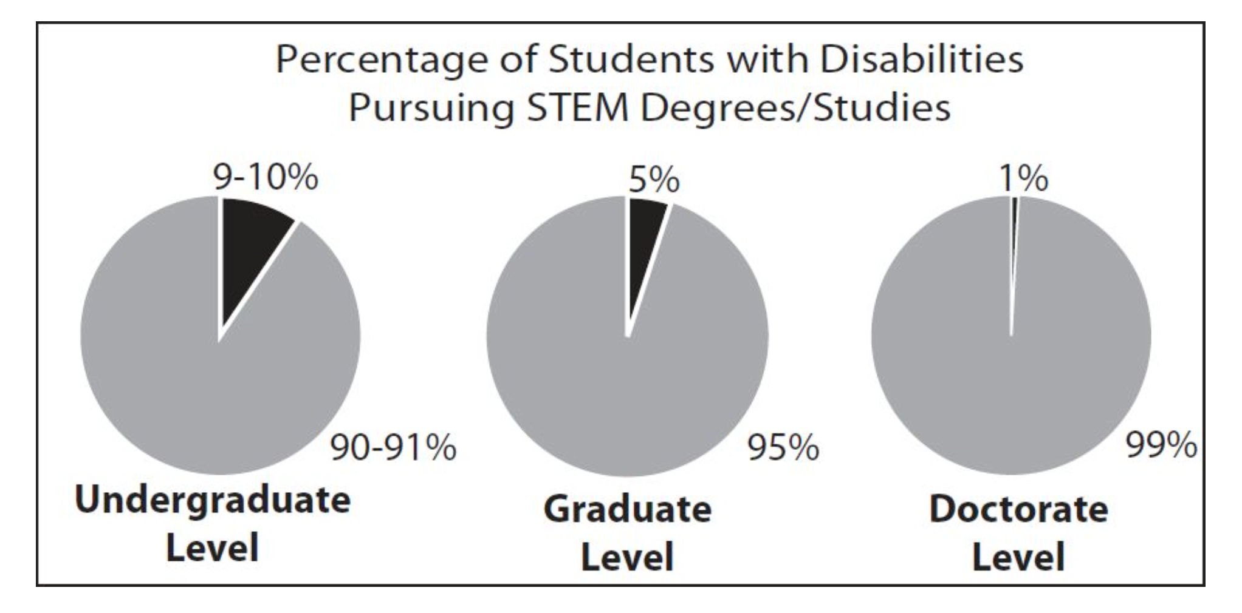
Motivation
1 in 5 Americans is disabled (CDC, 2015)
ADA: Americans with Disabilities Act (1990) prohibits discrimination…
BUT Disability Offices and ADA compliance varies from institution to institution
Graph shows percentage of students with disabilities in STEM degrees: 10% undergraduate; 5% graduate level, 1% who complete PhD programs.

Slide 4
Accessibility 101
Intersectionality Reminder
Medical vs. Social Model of Disability
Visible vs. Invisible Disability, risks of disclosure
ADA Compliance (and its limits)
Common forms of Prejudice & Discrimination
Representation
Movement towards Self-Advocacy
ADA Compliant vs. Barrier-free vs. Universal Design

Slide 5
Defining our terms:
Disability: Condition which subjects individual to structural societal barriers
Visible & Invisible
Physical, Mental, & Cognitive
Medical vs. social models of disability: Individual is sick/flawed vs. society imposes barriers unequally
Universal Design: “barrier-free” -- equally accessible to disabled/neuroatypical and able-bodied/neurotypical
Self-advocacy: “Nothing About Us Without Us”
Ableism/Disableism: Institutionalized/societal discrimination

Slide 6
Representation matters
Person-centered language:
“Persons with Disabilities” (PWDs) rather than “disabled people”
Inspiration Pr0n: Stories which focus on PWDS “overcoming” their disability, designed to inspire/motivate able-bodied audience.
Self-advocacy: “Nothing About Us Without Us”
Are disabled voices centered in your disability-focused organization?

Slide 7
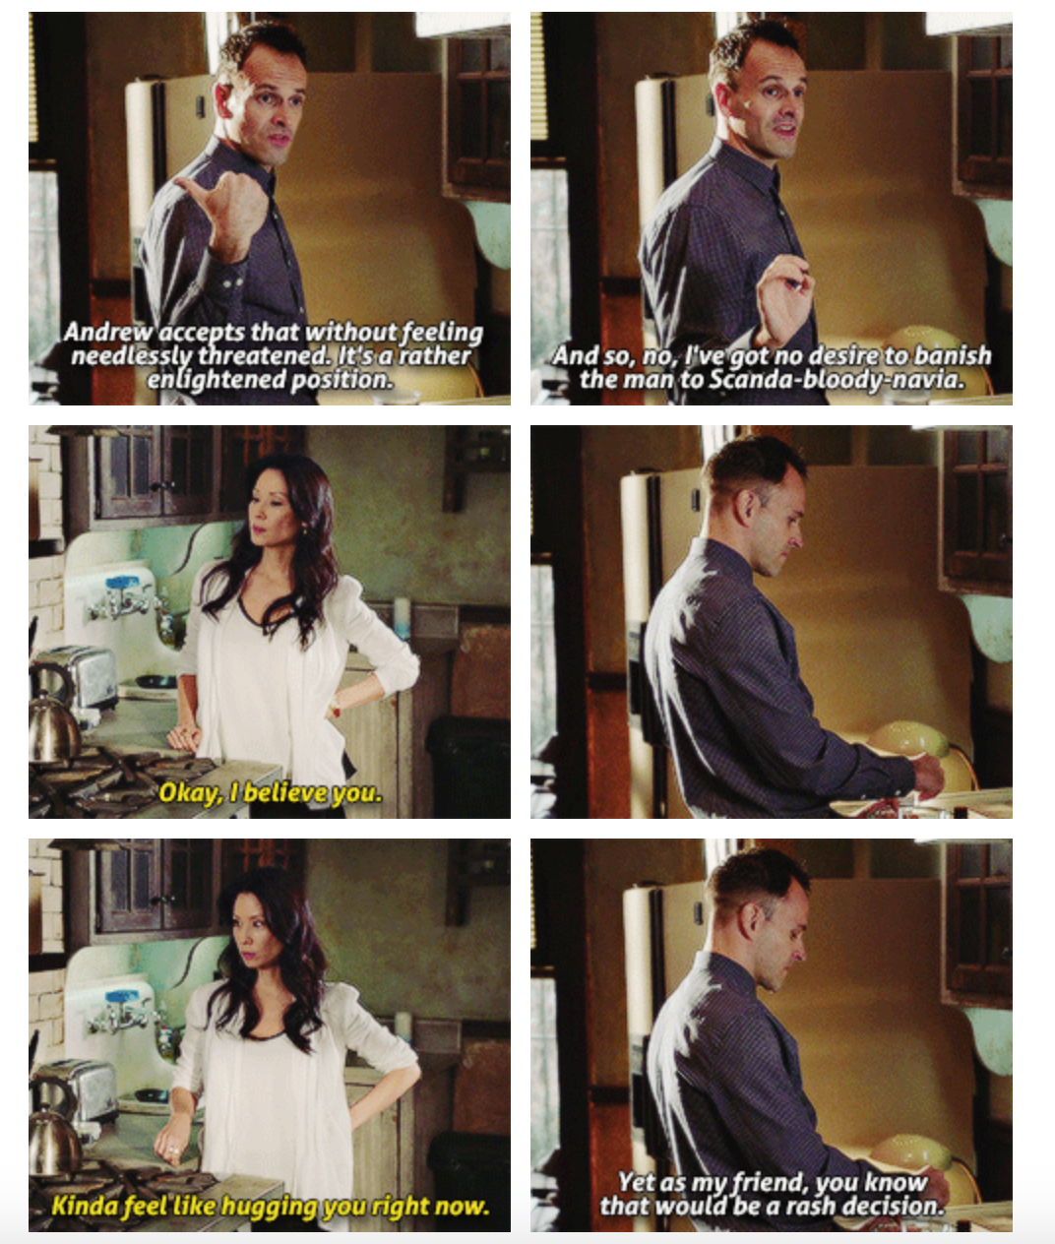

Bad Representation
Better Representation

Slide 8

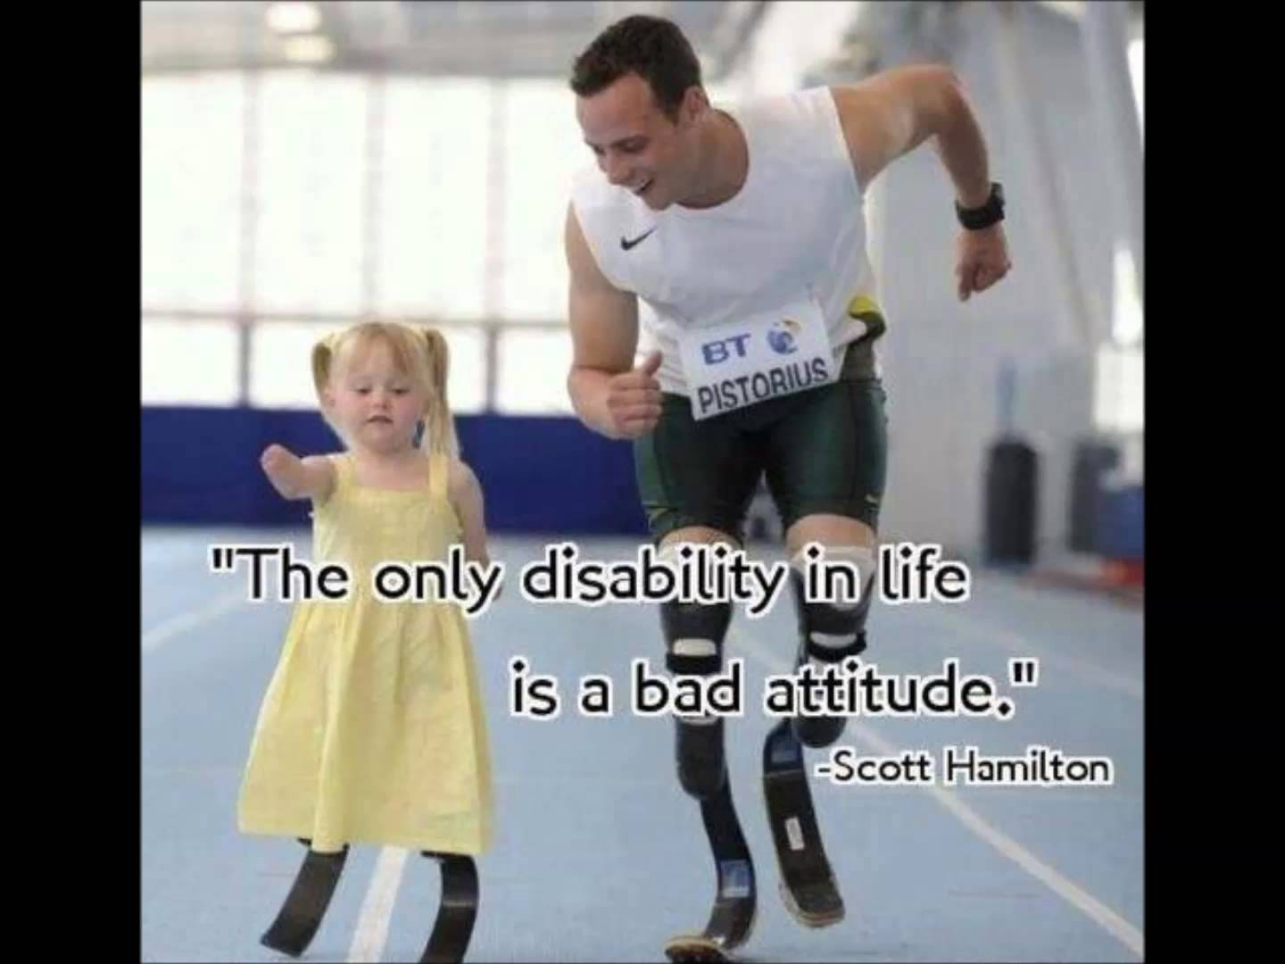
Bad Representation
Better Representation

Slide 9


Bad Advocacy
Better Advocacy

Slide 10
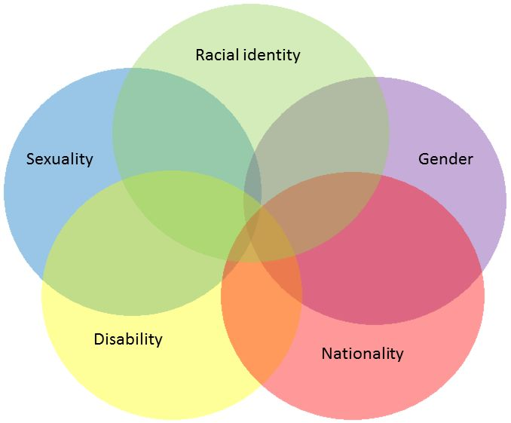
Intersectionality reminder
Disability incidence rates vary with racial demographics
Associated with socioeconomic factors, lifespan, medical access
URMs disproportionately misdiagnosed with learning disabilities
Psychological barriers inflicted on LGBTIAQ+ identities
Incidence of chronic disease, mental illness among women
Venn diagram of factors including racial identity, gender, nationality, disability, and sexuality.
[1] Dunlop et al. 2007, American Journal of Public Health
[2] Elementary & Middle Schools Technical Assistant Center

Slide 11
Americans with Disabilities Act 1990
Makes discrimination against Americans with disabilities illegal; requires “reasonable accommodations” for employees; mandates accessibility on public transport
Problems:
Requires disclosure to obtain accommodation
Possible discrimination
Litigation only way to deal with non-compliance
The “reasonability” clause…

Slide 12
ADA Complaint vs. Barrier-Free vs. Universal Design:
ADA Compliant = Minimum requirements to avoid lawsuits...
Barrier-Free = Anticipates and removes barriers to PWDs
Universal Design = Anticipates and removes barriers to everyone

Slide 13
Examples:
ADA Compliant = Ramp to one entrance, accessible bathroom stall on one floor, doors with push-buttons.
Barrier-Free = Ramps at all entrances, accessible bathrooms on all floors, doors with push-buttons, lowered sinks in every bathroom.
Universal Design = No-step entryways, accessible & gender-neutral bathrooms with change tables on all floors, doors & faucets that are motion-activated, sinks at varying heights.

Slide 14
Universal design
Term coined by architect Ronald Mace
A method for creating spaces and products that are aesthetically pleasing and accessible to anyone regardless of age, status, ability, etc.
Selwyn Goldsmith
Took UD and pushed for it in the context of accessibility for people with disabilities
Designing for the Disabled (1963)
Pioneered curb cuts
Barrier-free vs accessible vs universal
When something is designed to be beneficial to the most people possible, inclusion in action: everyone gains

Slide 15
Universal design
Overarching theme: think about the user experience.
Universal design isn’t an abstract concept: if you’re thinking about user experience and accessibility, you’re doing it!
Things to consider:
Equitable use
Flexibility
Simplicity/intuitiveness
Perceptibility of information
Tolerance for error
Physical effort required
Size/space for use
-Center for Universal Design, NCSU

Slide 16
Universal design in the classroom
Practice inclusive language, engagement
Person-first
Avoid old-fashioned terms like “handicapped”
Avoid activities that require physical activity as sole form of engagement (e.g., a running group/journal club)
State clearly your intent to be inclusive in a syllabus/course webpage statement, e.g.:
“Accessibility and learning needs: If you have any kind of disability, whether apparent or non-apparent, learning, emotional, physical, or cognitive, or you need alternative implementations of my lectures, assignments, or other materials for any reason, please contact me to discuss how I can help you learn. I try to provide a positive and supportive learning environment for everyone, and it’s always helpful for me to hear what works best for you. Note this building has accessible and non-gender-specific restrooms [location here].”
-Jennifer Hoffman, University of Denver; adapted from Lydia X. Z. Brown (@autistichoya)

Slide 17

Universal design in the classroom
Use Styles in Word, Google docs
Saves you time
Heading-level tags added automagically
Avoid text in boxes/shapes in Word or Powerpoint!
They appear blank to screen readers
Use Powerpoint templates, they are accessible
Outline view shows you what a screen reader will find
Test PDFs
Use OCR software if PDF pages are images, not text
Tag images in Acrobat Pro
Text box test
Gratuitous bunny gif

Slide 18

Universal design in the classroom
Insert alt-text, but not too much. Think: about tweet-length (140chars)
<img src=“images/cappy.gif” alt=“Adorable panda (black/white) bunny”>
Describe hyperlinks based on context
Digitally: embed and use alt-text/in-line description
On paper: copy/paste full link
:
Notes:
Put in an html tag here and an image showing what alt-text looks like when you mouse over

Slide 19
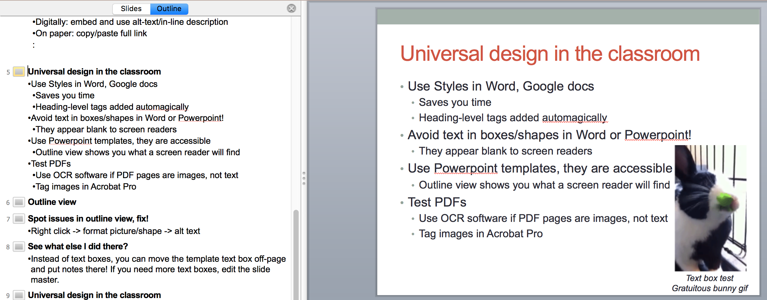
Outline view
Note how image, text box below it, don’t appear in outline view
Notes:
Notice the image isn’t in the outline

Slide 20
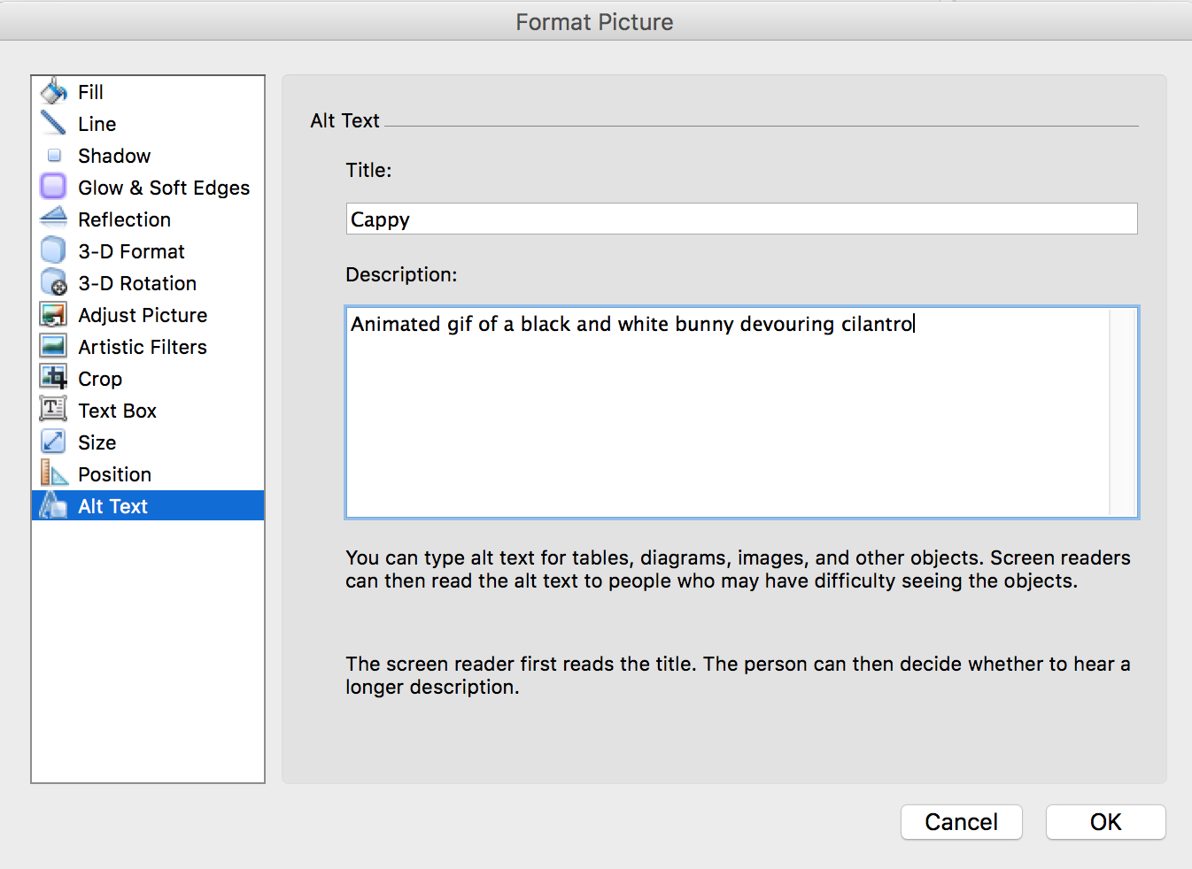
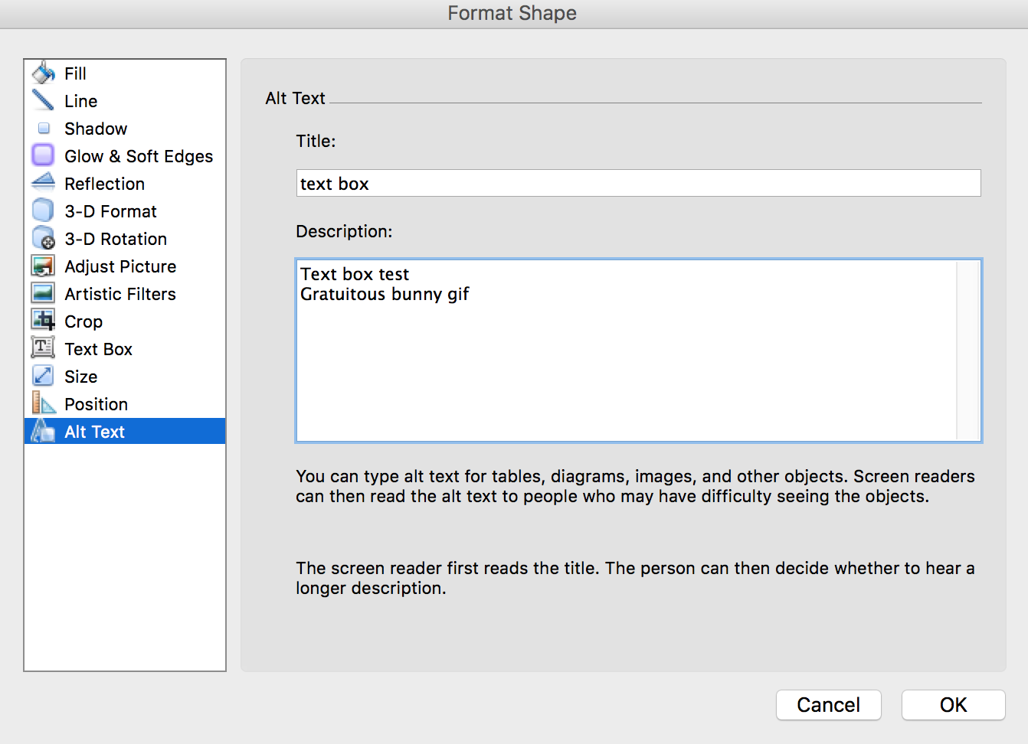
Spot issues in outline view, fix!
Right click -> format picture/shape -> alt text
Notes:
Note alt text doesn’t show up in outline view, but screen readers do know it’s there

Slide 21
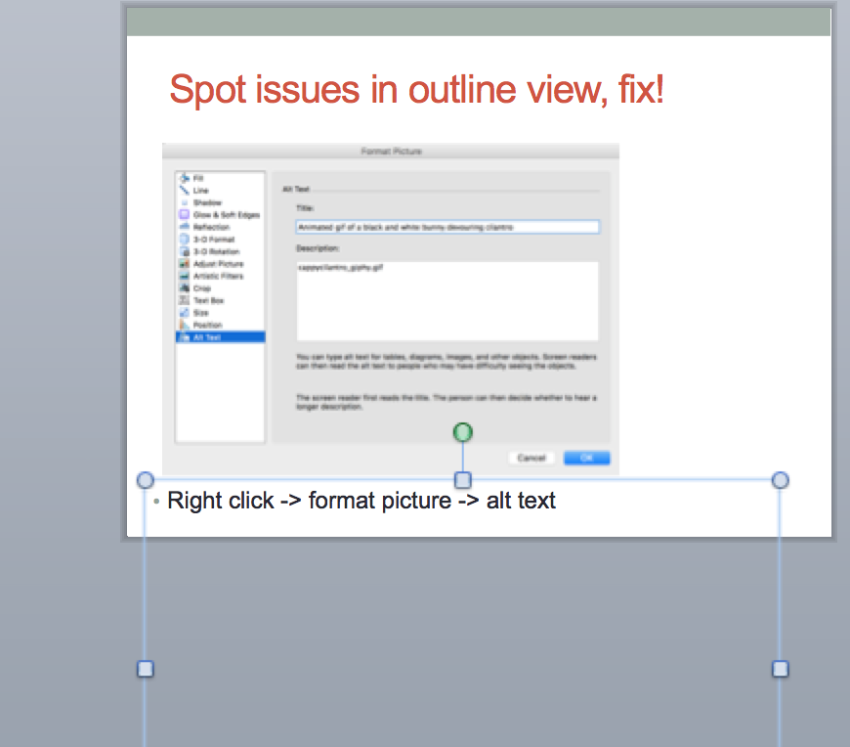
See what else I did there?
Instead of text boxes, you can move the template text box off-page and put notes there! If you need more text boxes, edit the slide master.

Slide 22
Universal design in the classroom
Multimodal access
Don’t ban laptops- use them for class engagement: chat, text-based question submission, following along with local copy of lecture slides
Caption video content (YouTube’s automatic captioning is decent)
Provide multiple file formats: if providing a PDF made from a Word doc, also provide Word doc so users can manipulate to their own needs (e.g., font, layout)

Slide 23


AAS WGAD
Working Group on Accessibility and Disability
Formed January 2016
Charge: chip away at/eliminate barriers to participation for astronomers with disabilities
Resources posted at wgad.aas.org
Publication accessibility
Meeting accessibility
Database accessibility
Coming soon: site visit guidelines

Slide 24
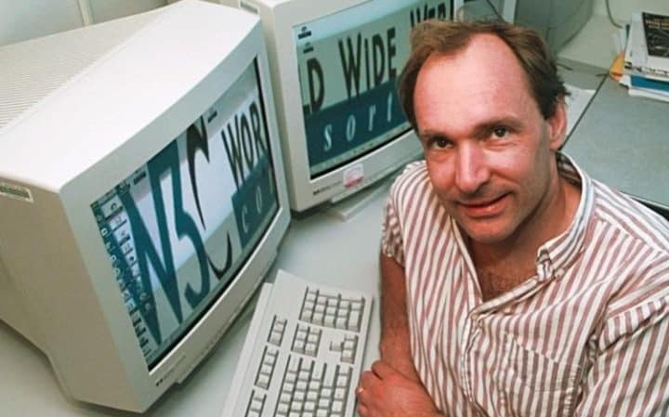
Web accessibility
The power of the Web is in its universality. Access by everyone regardless of disability is an essential aspect. Tim Berners-Lee, W3C Founder and inventor of the World Wide Web

Slide 25

It’s the law!
United Nations Convention on the Rights of Persons with Disabilities
Section 508 Rehabilitation Act, amended in 1999
Oct 2010, 21st Century Communications and Video Accessibility Act
Americans with Disabilities Act – increasingly, court interpretation includes web sites and applications

Slide 26

Global Standards
WCAG - Web Content Accessibility Guidelines. International standards for the web
ATAG - Authoring Tool Accessibility Guidelines. Vendor standards for interoperability
UAAG - User Accessibility Guidelines for browsers and assistive technologies
ARIA - Accessible Rich Internet Application research for emerging technologies
www.w3.org/WAI
Notes:
Shared understanding of requirements among:
Consumers
Developers
Makers of browsers and AT devices
Authoring Toolmakers (CMS, LMS, etc)
“How to” Techniques and testing criteria for
content creators

Slide 27
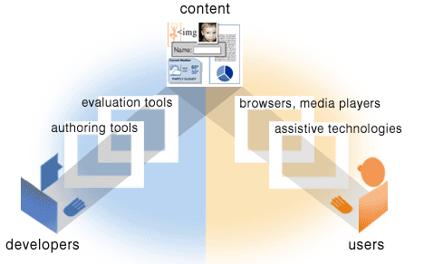
Components of Web Accessibility
ATAG (authoring tools)
Diagram of the relationship between authoring and evaluation tools, Web content, and user agent tools such as browsers and assistive technologies. As each component adheres to common standards, accessibility and interoperability are improved. At the W3c, groups of experts work in collaboration on the
ATAG – authoring tools accessibility group;
WCAG – web content accessibility group; and UAAG – user agent accessibility group, and others.
WCAG (web content)
UAAG (user agent)

Slide 28
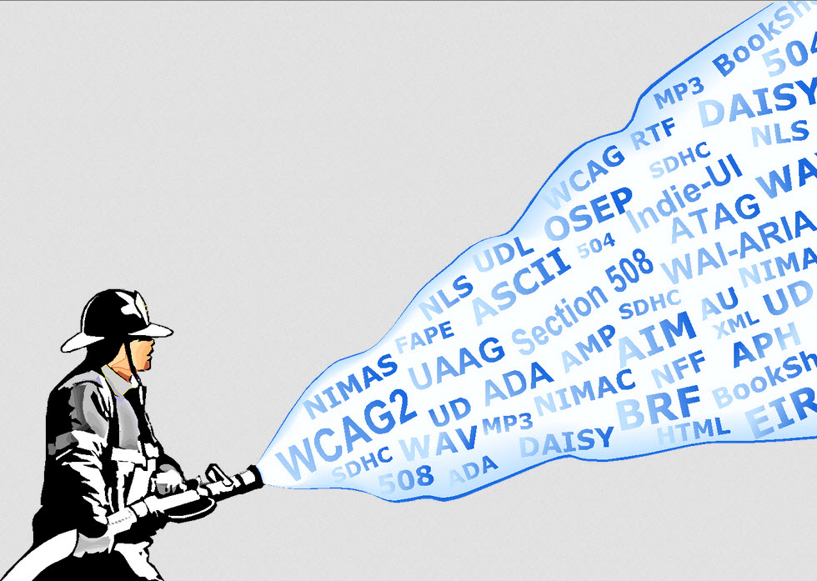
Graphic image
Cartoon fireman holds firehose with both hands as large spray emerges with acronyms of laws and standards that apply to web accessibility: WCAG, ATAG, UAAG, ADA, BRF, NCAM, Section 508, etc

Slide 29
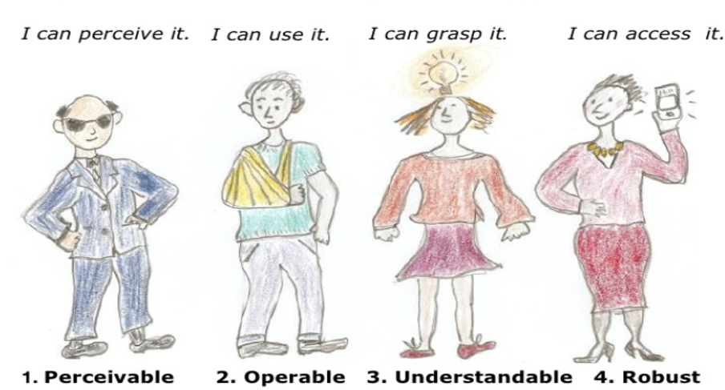
W3C WAI Web Accessibility Principles
Cartoon figures illustrate the principles:
Perceivable – Blind man with sun glasses says “I can perceive it”
Operable – Boy with arm in a sling says “I can use it”
Understandable – Girl with light bulb above her head says “I can grasp it.”
Robust – Woman holding a cell phone says “I can access it.”

Slide 30

Common Barriers
Alternatives for image content
Charts and tables
Generic link text – “click here” “read more”
Color and contrast
Embedded media – captions and controls
Content Structure
Data tables
Headings
Lists
Dynamic content
Reading order

Slide 31
Inclusive design drives innovation
Typewriter - Pellegrino Turri in 1808 for his blind friend Countess Carolina Fantoni da Fivizzano
Telephone - Alexander Graham Bell invented telephone while working at school for Deaf
Punch cards – Herman Hollerith, learning disabled, in 1890 used punch card system to tabulate U.S. Census.
Siri – Introduced by Apple so blind students at California State University had usable device controls
diversity + inclusion = innovation

Slide 32
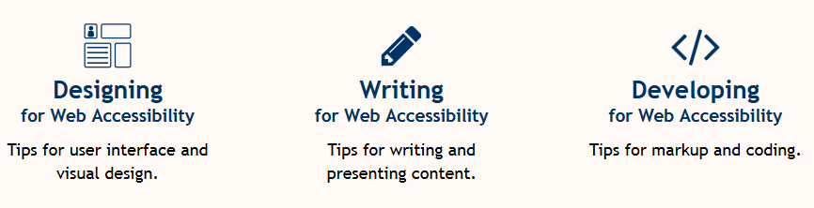
Free resources at W3C/WAI
Education and Outreach Working Group publishes resources to support web accessibility best practice at W3.org/wai
Designing for Web Accessibility – Tips for user interface and visualgn
Writing fro Web Accessibility – Tips for writing and presenting content
Developing for web accessibility – Tips for mark-up and coding

